Slide 1
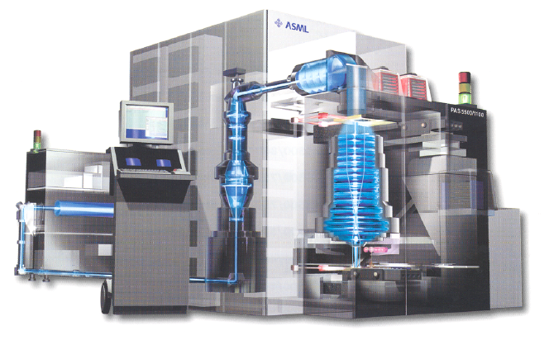
Lecture 4
Chemical Engineering for Micro/Nano Fabrication

Slide 2
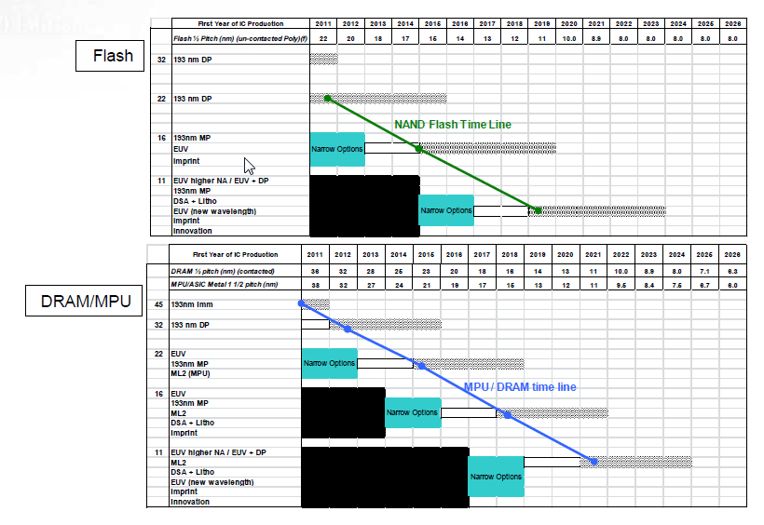
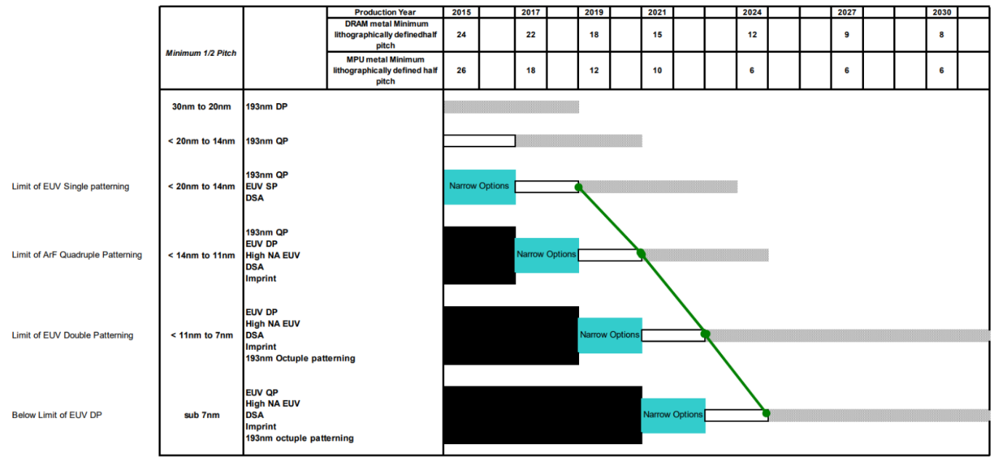
ITRS Lithography Roadmap 2011
DRAM/MPU
2015

Slide 3

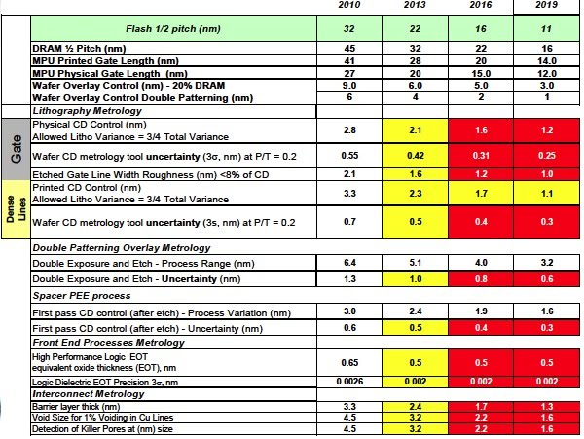
NTRS / IRDS

Slide 4
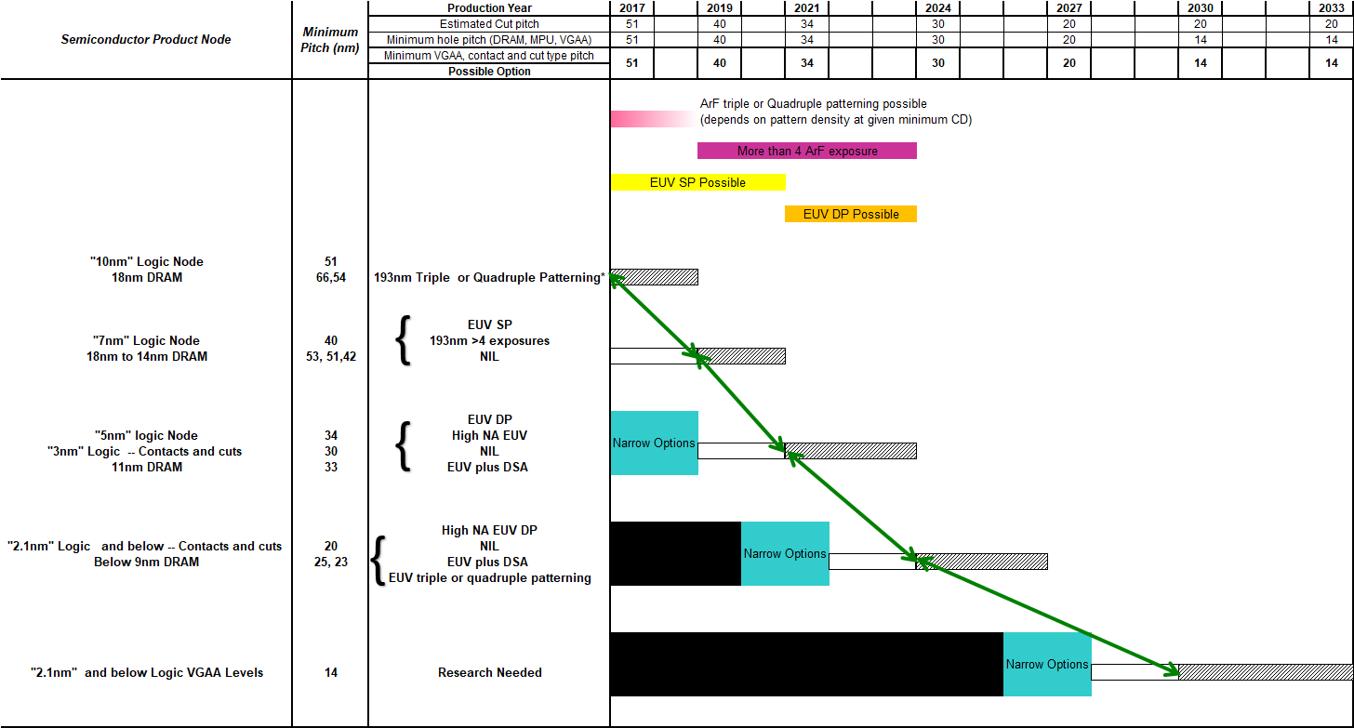
Hole Type Patterns 2018 draft
This includes contacts, vias and cut patterns

Slide 5
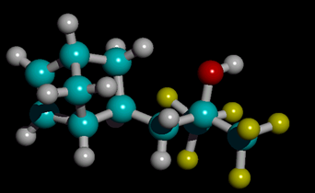
From the NTRS
2010
2013
2016
2018
MPU ½ Pitch (nm) (uncontacted gate)
45
32
22
18
Overlay (nm)
18
12.8
8.8
7.2
MPU gate in resist (nm)
25
18
13
10
MPU gate length after etch (nm)
18
13
9
7
Gate CD control (nm, 3-sigma)
1.6
1.2
0.8
0.6
Manufacturable solutions exist and are
being optimized
1
4
r₁₂= 8.69 Å
Manufacturable solutions are known
NBHFA
2
Manufacturable solutions are NOT known
3
r₃₄=4.32 Å

Slide 6
IRDS Patterning Conclusions 2018
Patterning innovations will be needed for the next 10 years to support the More Moore roadmap
Hole type patterns will become more difficult than line and space type patterns
Different types of computer chips will use different approaches for their advanced patterning
Switching to vertical scaling for logic in the future could fundamentally change the critical challenges for patterning

Slide 7
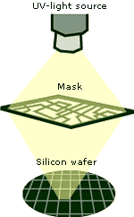
The Basic Components of a
Generic Optical Projection System
Mask
Lens
Light Source
Lens
Condenser
Lens
Projection
Lens
Resist
Coated
Wafer
Illumination system
Notes:
The mask is usually illuminated in transmission and the demagnification of the lens may vary between one and twenty.
The light source and the condenser lens combination is called the illumination system.
The term “lens” is used to refer to a system of (possibly many) elements each of which is either an individual piece of glass (refractive element) or a mirror (reflective element).
The purpose of the illumination system is to deliver light to the mask with proper intensity, directionality, spectral characteristics and uniformity across the field.

Slide 8
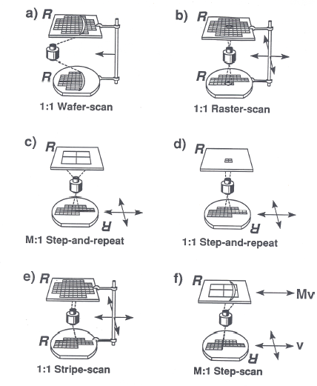
Many Projection Design Options
Notes:
Methods of image partition
Enables full field image projection
Throughput Considerations: TwinScan XT:400F i-Line scanners -- 150 wafers/hr for 24 hrs, producing nearly 3600 wafers in a single day earlier this spring.

Slide 9
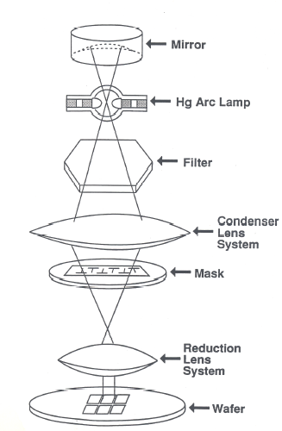
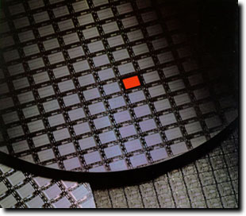
Step and Repeat Principle
[Reticle]
Notes:
Note: When the “Master Image” contains all of the chip patterns, we refer to it as a photomask. When it contains the pattern of only a single chip (or subset) as shown in the diagram, we call it a reticle.
Note the ENTIRE area of the reticle to be exposed is illuminated when the shutter is opened.

Slide 10
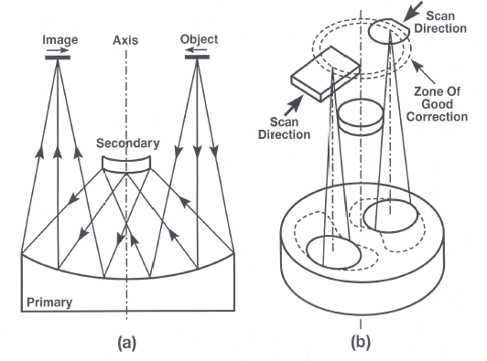
Principle of the Micralign® Scanner System

Slide 11
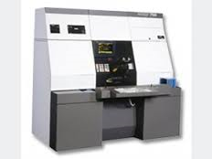
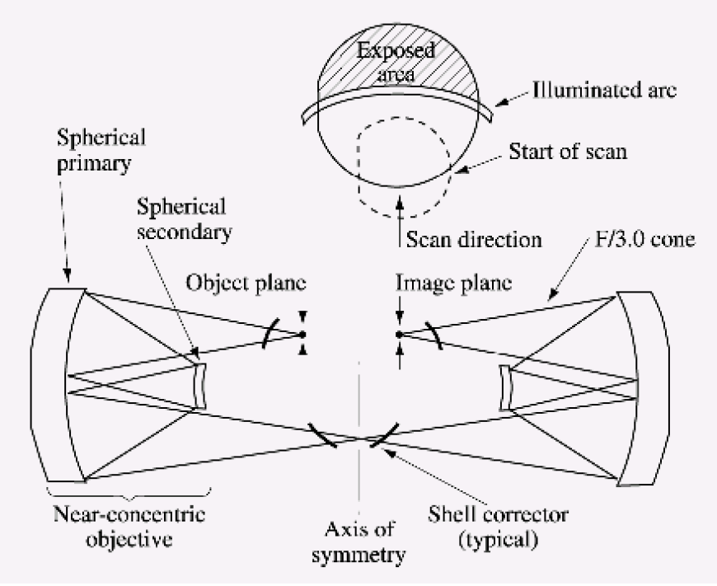
Micralign Full Wafer Scanner Design

Slide 12
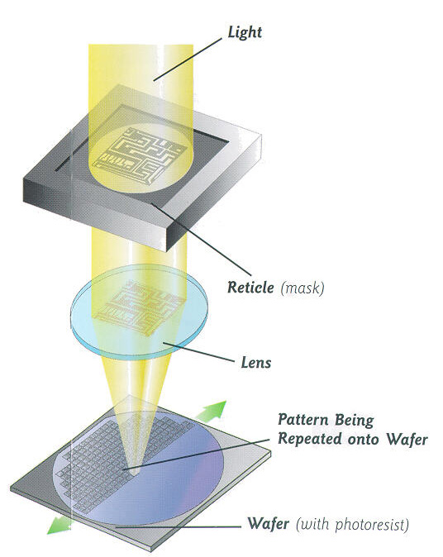
Projection Exposure Systems
λ
R= k
NA

Slide 13
Resolution Limit of the Projection Printing
Theoretical Resolution
λ
θ_{max}
F= k₁
NA
F :
λ :
k₁ :
NA :
n :
Minimum feature size
Exposure wavelength
Process-dependent factor
Numerical aperture of lens system
Index of refraction (for air, n ≈ 1)
Aperture
Entrance
Pupil
NA = n sin θ_{max}
Feature size is directly related to the
wavelength of the exposure radiation

Slide 14
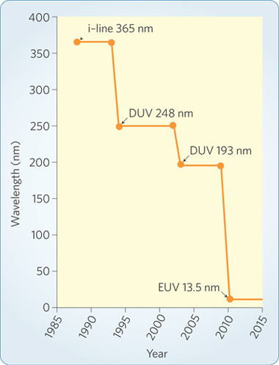
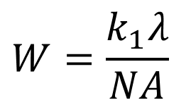
Reducing wavelength
W = Resolution (nm)
k₁ = Process-dependent constant (k₁ > 0.25)
λ = Wavelength
NA = Numerical aperture = n sin(θ)
Cost: >$250M/tool ?
Wagner, C.; Harned, N., EUV lithography: Lithography gets extreme. Nat Photon 2010, 4 (1), 24-26.

Slide 15
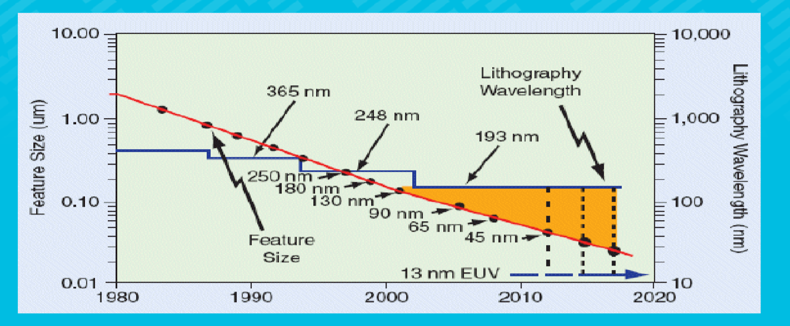
Wave Length Reduction History

Slide 16
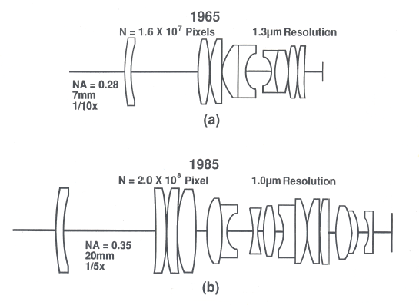
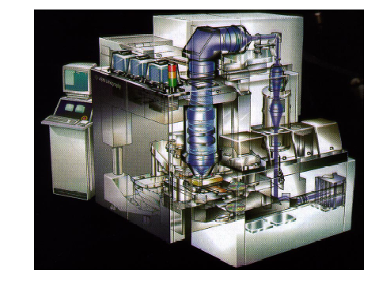
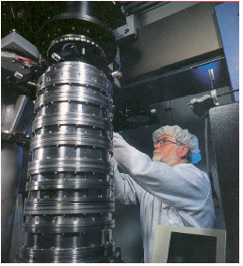
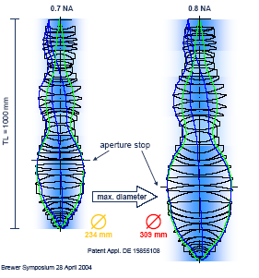
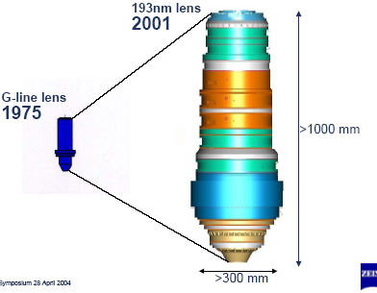
Lithographic Lens Evolution
Starlith 500 Lens (Zeiss)
Notes:
The PAS 5500/850 248nm DUV step and Scan
Starlith 500 Lens from Carl Zeiss – used in ASML PAS 5500/550B scanner for 180nm processes and a 26x33mm field.

Slide 17
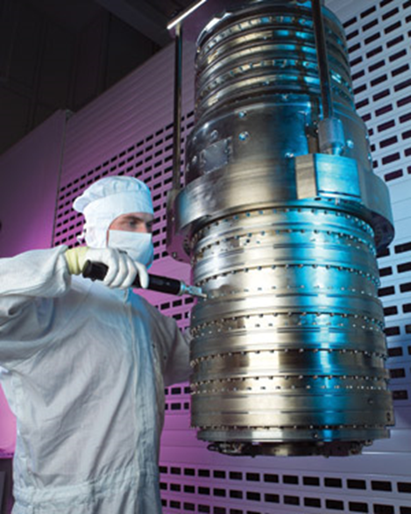
193 nm Immersion Lens
The stepper lens has a numerical aperture of NA = 1.35(huge!) and is intended for use in immersion lithography, a technique that replaces the air gap between wafer and stepper with water or another fluid. Zeiss notes that the device is, in some sense, the end of the art.
The lens is designed for an UV light source with a wave length of 193 nm, which needs an ArF (yes, "Argon Fluoride") Laser. Remember that the visible spectrum ends around 400 nm. UV radiation from the sun, for comparison, spans the range (315 - 400) nm ("Ultraviolet A") and (280 - 315) nm ("Ultraviolet B").
The producer of this lens is Carl Zeiss SMT AG , Germany.

Slide 18
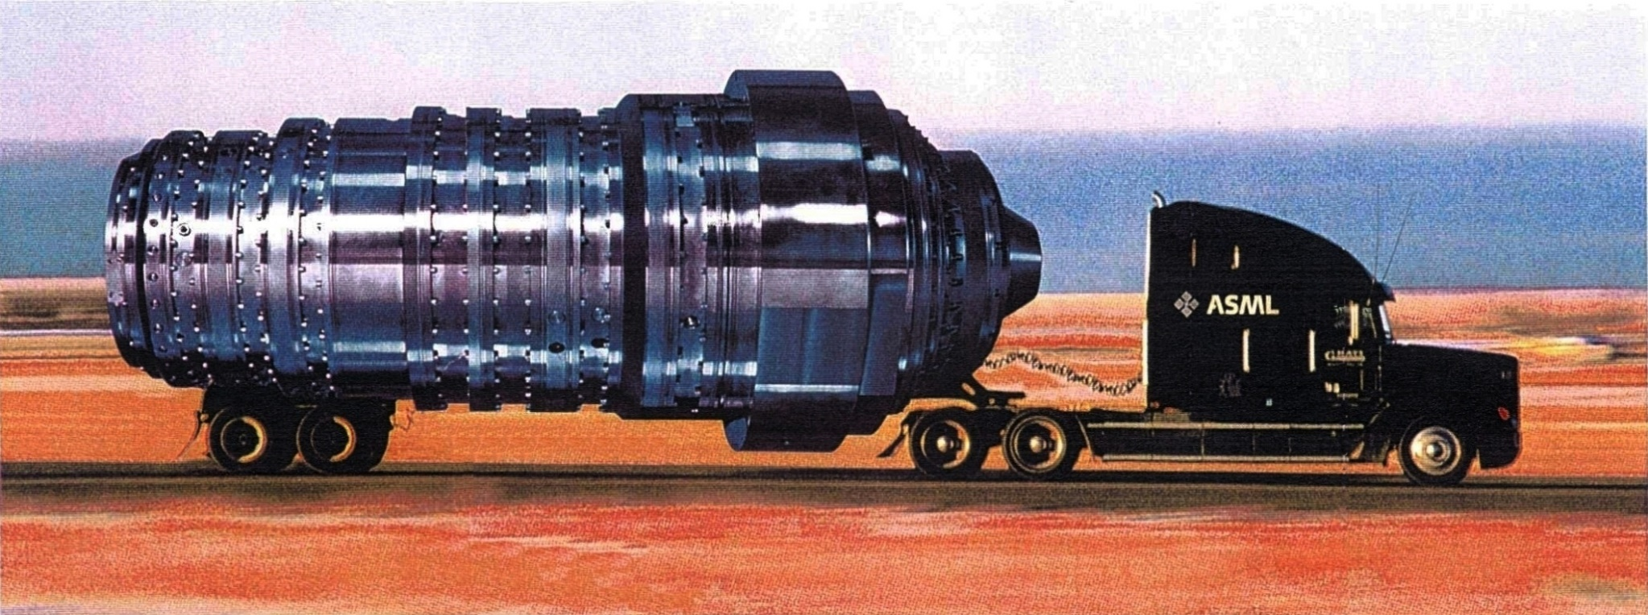
A Prophetic Advertisement??
Size Matters????

Slide 19
Resolution Limit of the Projection Printing
Theoretical Resolution
λ
θ_{max}
F= k₁
NA
F :
λ :
k₁ :
NA :
n :
Minimum feature size
Exposure wavelength
Process-dependent factor
Numerical aperture of lens system
Index of refraction (for air, n ≈ 1)
Aperture
Entrance
Pupil
NA = n sin θ_{max}
Feature size is directly related to the
wavelength of the exposure radiation

Slide 20
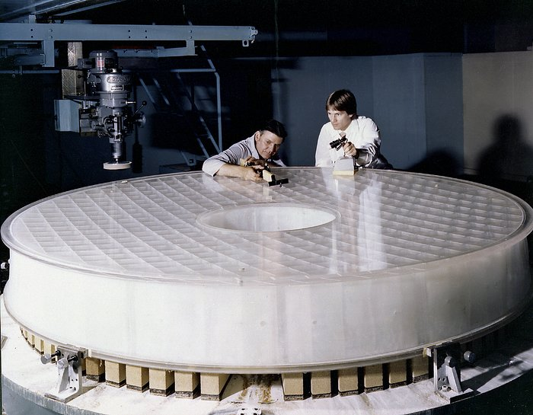
Grinding the Primary Mirror for Hubble
http://people.tamu.edu/~v-buenger/658/Hubble.pdf

Slide 21
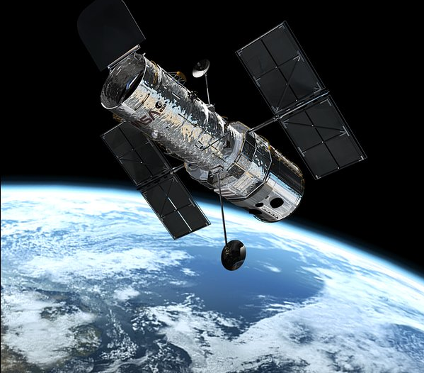
Hubble Telescope
Cost $1.5 Billion

Slide 22
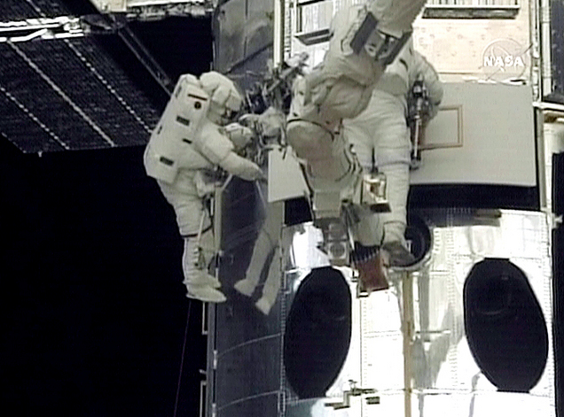
Repairing the Telescope

Slide 23
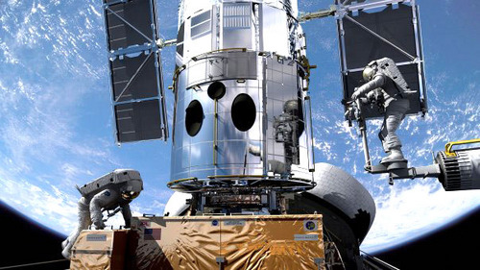
Repairing the Telescope

Slide 24
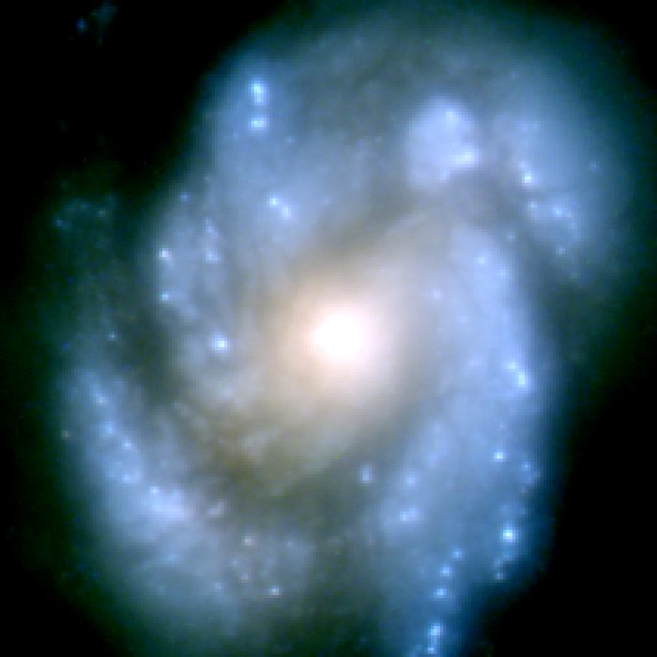
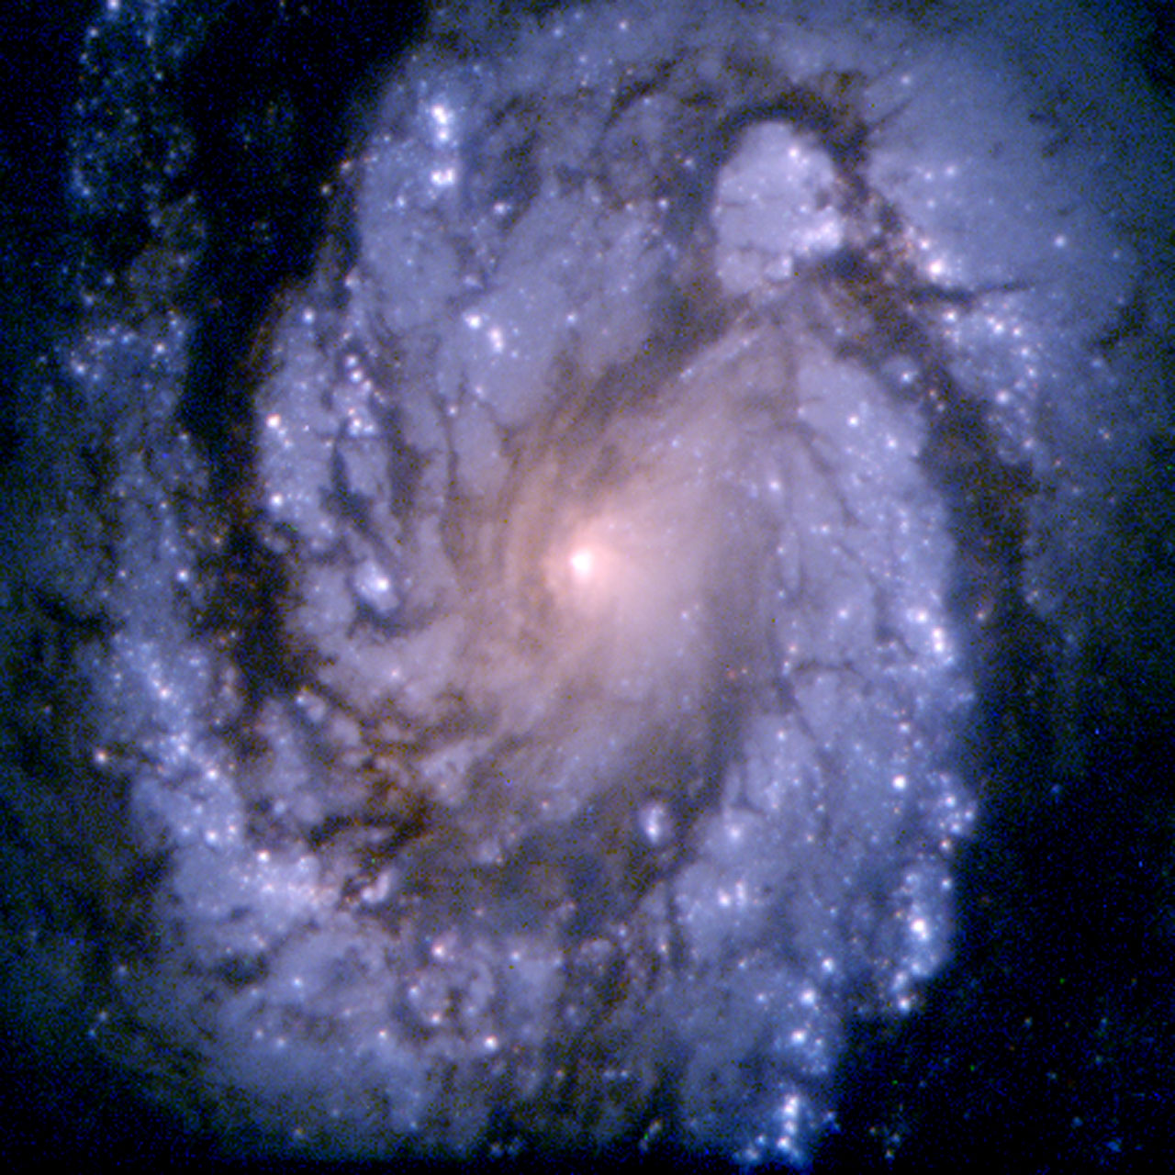
Spiral Galaxy Before and After

Slide 25
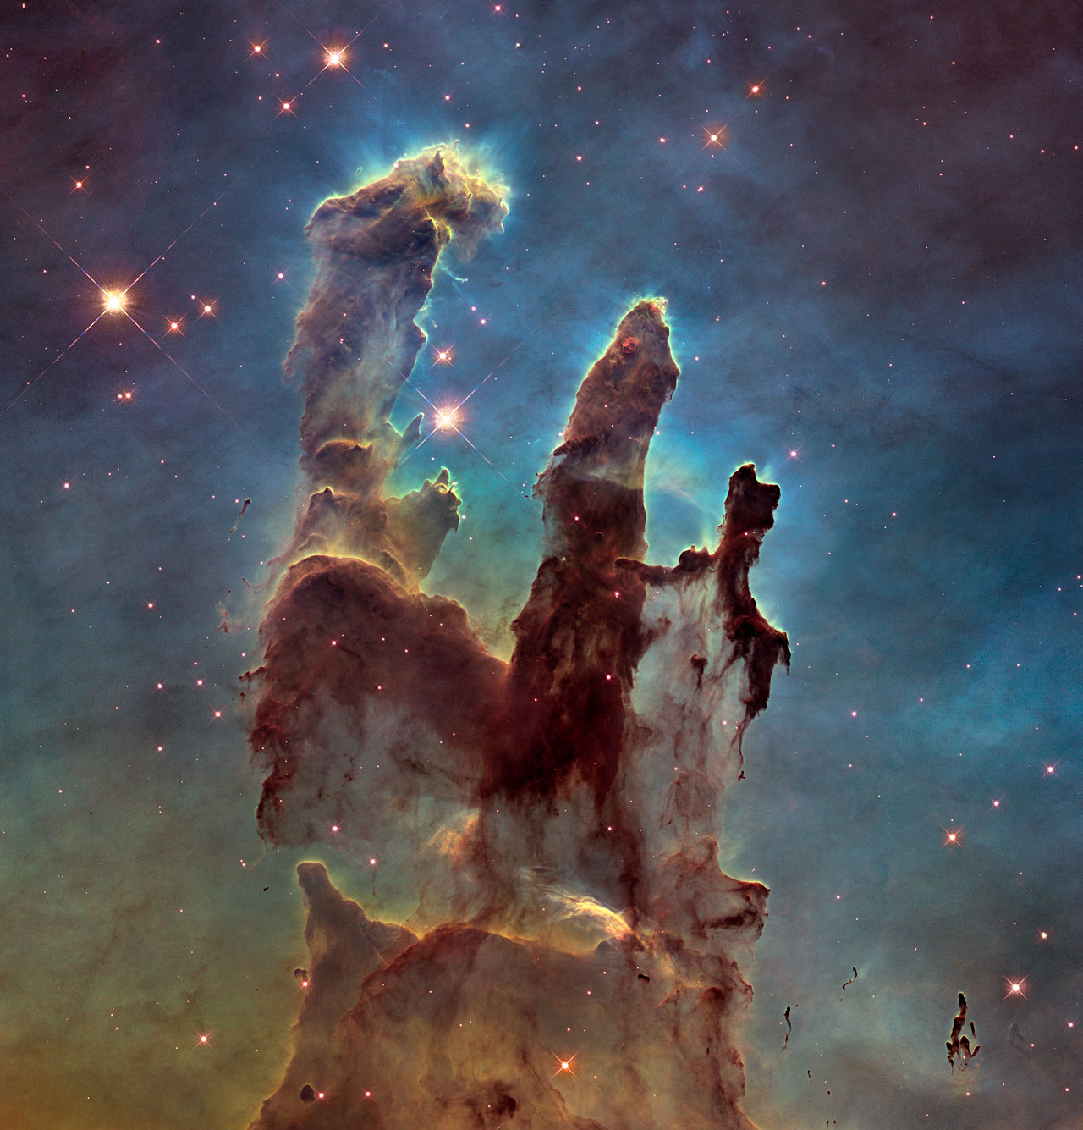
Eagle Nebula

Slide 26
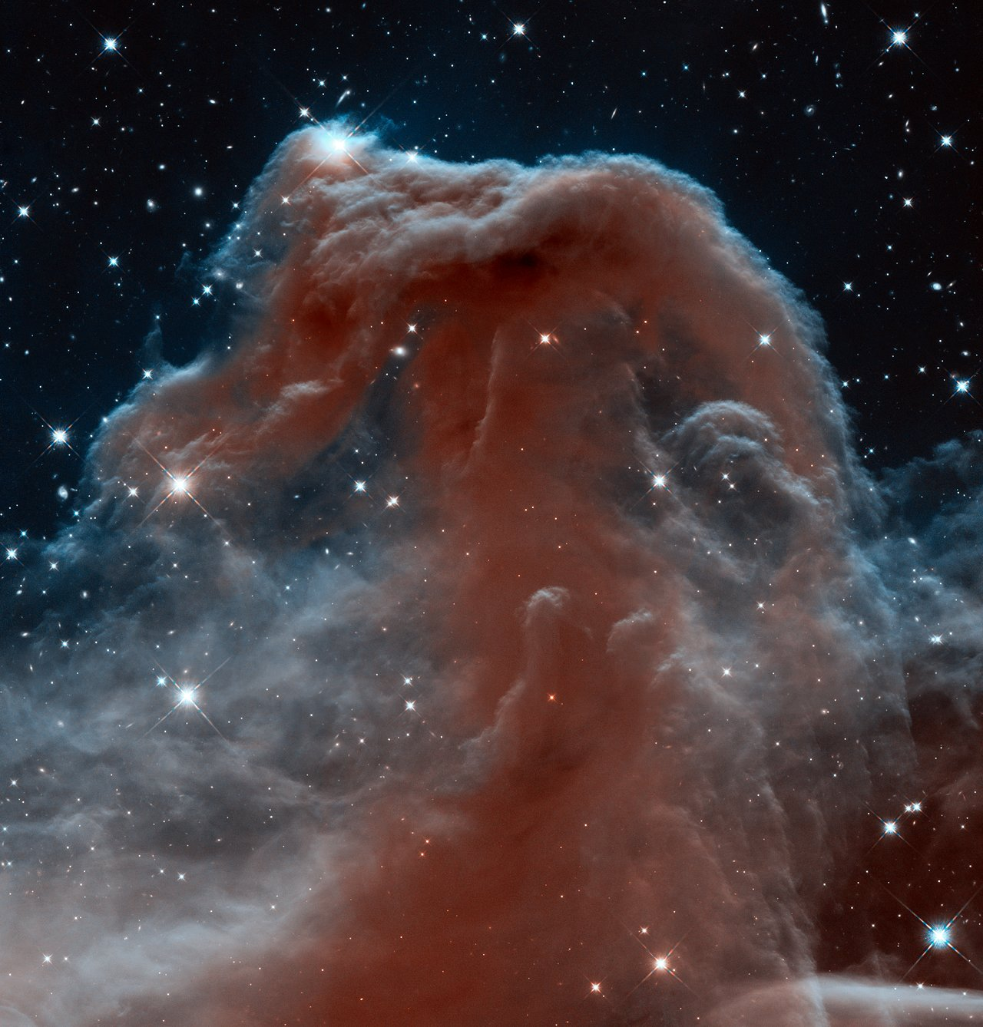
Horse Head Nebula

Slide 27
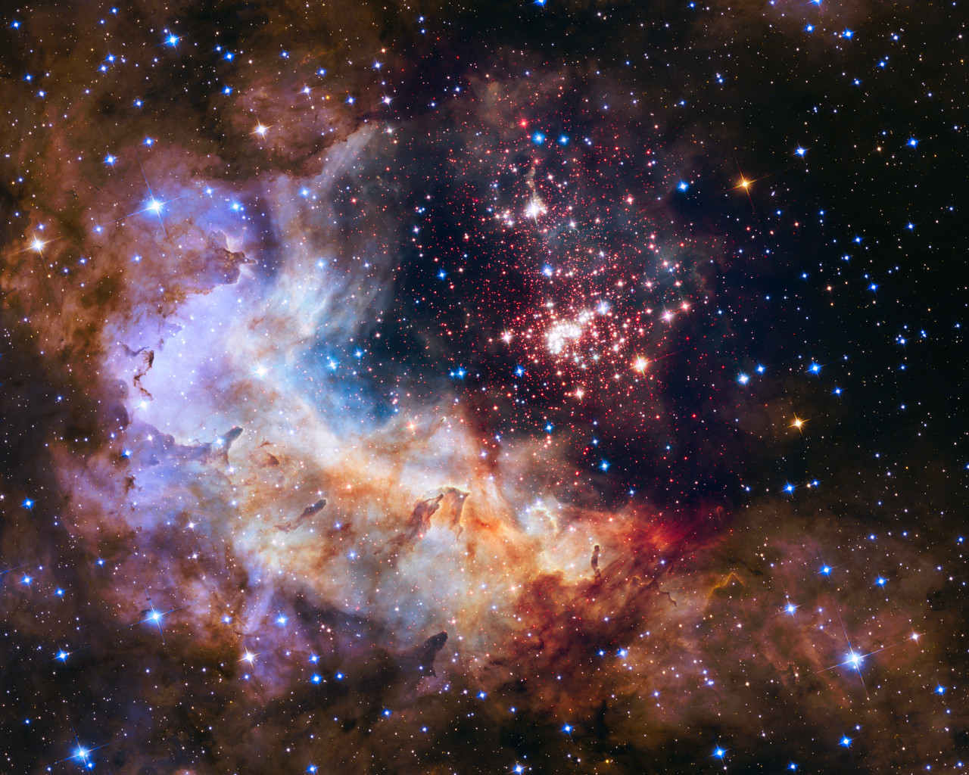
25th Anniversary Image

